Slide 1


VocalMart: AI Voice-Based Inventory Management
Introducing VocalMart, a smart voice-activated system designed for effortless inventory management in local businesses.
Team No. 184
Kunal Chaudhary-2401420049[Leader](Backend Developer)
Dhruv Sharma-2401420050(Frontend Developer)
Utsav Singhal-2401420041(Database Manager)
MD.Anas Khan-2401420035(Design Superviser and Tech Backup)

Slide 2


Market Need and VocalMart
Introduction
Think of your neighborhood shop, the one where the owner greets you by name and always knows what you need. Behind that warm smile is someone juggling stock, bills, and sales often with just a pen and paper.
Many local shopkeepers still manage everything manually, leading to stress, errors, and lost time. Not because they don’t work hard, but because the tools out there aren’t built for them.
We created VocalMart to change that, a voice-enabled assistant that’s simple, bilingual, and designed for shopkeepers who just need a little tech help, without the complexity.

Slide 3


Challenges in Local Retail Inventory
Manual Tracking
Limited Automation
Leads to time loss and frequent mistakes in stock updates.
Small retailers lack access to tools that simplify inventory control.
Revenue Impact
And Many More—
Inventory errors cause lost sales and disappointed customers.
shopkeepers face many more challenges in local retail inventory such as, Data Loss Risk, Language and Tech Barriers.

Slide 4





Core Solutions
Voice-Activated Inventory Control
OpenAI Chatbot
Real-Time Updates
Automated Sales Reporting
Natural language commands such as "Add 5 Maggi to stock" are converted to SQL queries seamlessly.
Instant inventory level updates and sales reports for accurate stock management.
Commands like “Add 10 Parle-G” or “Remove 5 Milk packets” in Hindi or English, converted automatically to database actions.
Daily PDF reports generated from voice conversations for easy tracking.

Slide 5








Methodology
Problem Understanding & Planning
Technology Stack Selection
Modular Architecture Design
Choosing Python, Kivy, SQLite, ElevenLabs, and OpenAI APIs for robust development.
Identifying local shopkeepers' challenges and planning a voice-enabled AI solution.
Dividing the project into independent modules for voice input, chatbot, reporting, and export.
Database & Inventory Integration
Voice & Chat Functionality
UI/UX Design
Converting speech to text and back using AI for a natural voice assistant experience.
Creating a simple interface for easy inventory viewing and report exporting.
Storing product, stock, and sales data with automatic updates from chatbot commands.
Testing & Iteration
Iterative testing to handle various inputs and improve usability and reliability.

Slide 6
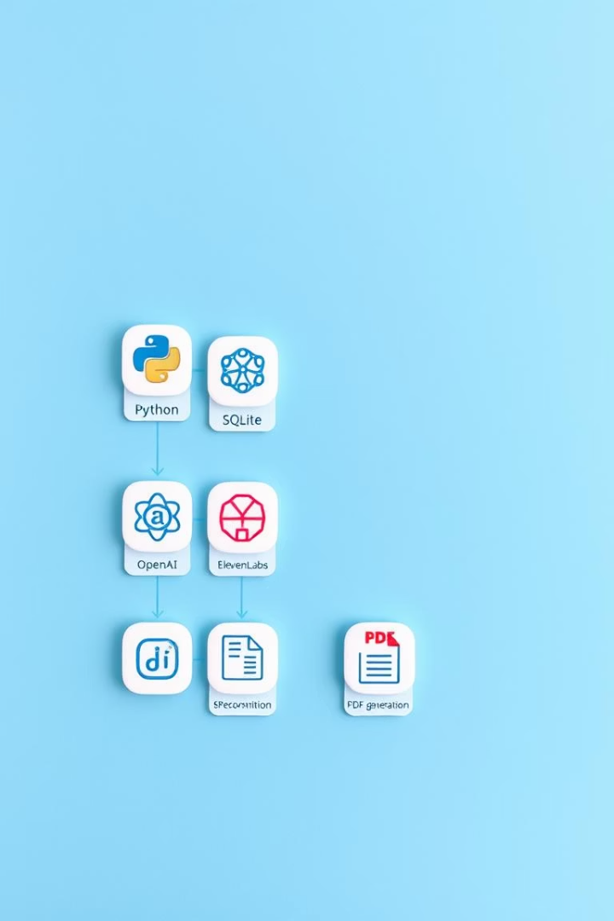







Technology Stack Overview
Python
Kivy
SQLite
Core programming language driving backend functionalities.
Framework for building the user-friendly graphical interface.
Lightweight database for real-time inventory management.
OpenAI API
Ai Voice Model
FPDF Module
Natural language processing to understand user commands.
The voice model uses AI to convert the real-time update texts to speech. This feature enables users to receive verbal notifications in natural human language
Using FPDF module to generate real-time reports for the sales data.

Slide 7

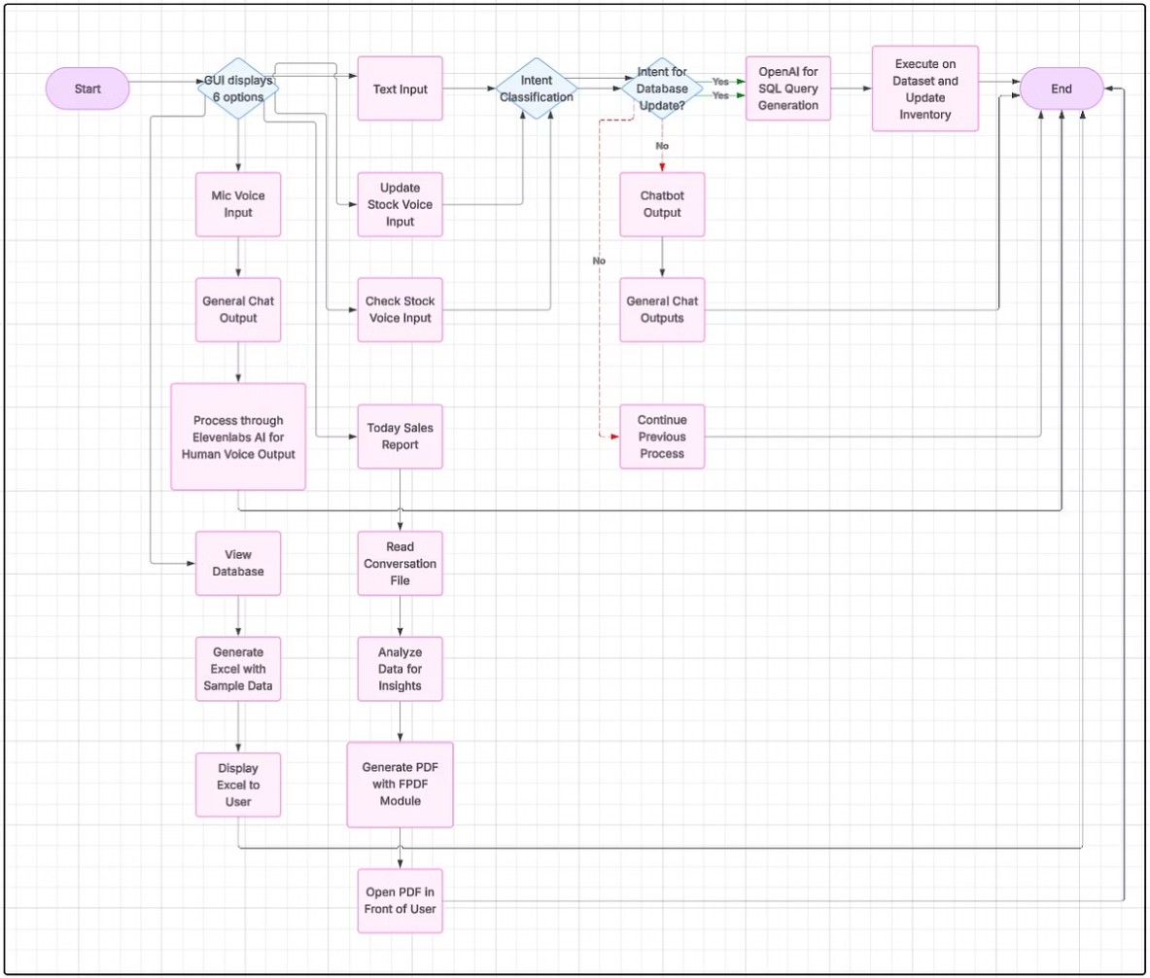
Workflow and System Architecture
Users interact via Kivy interface and voice/text commands, processed by OpenAI.
Commands convert to SQL for live inventory updates with voice feedback.
Sales reports and Excel exports enhance data visibility and management.

Slide 8

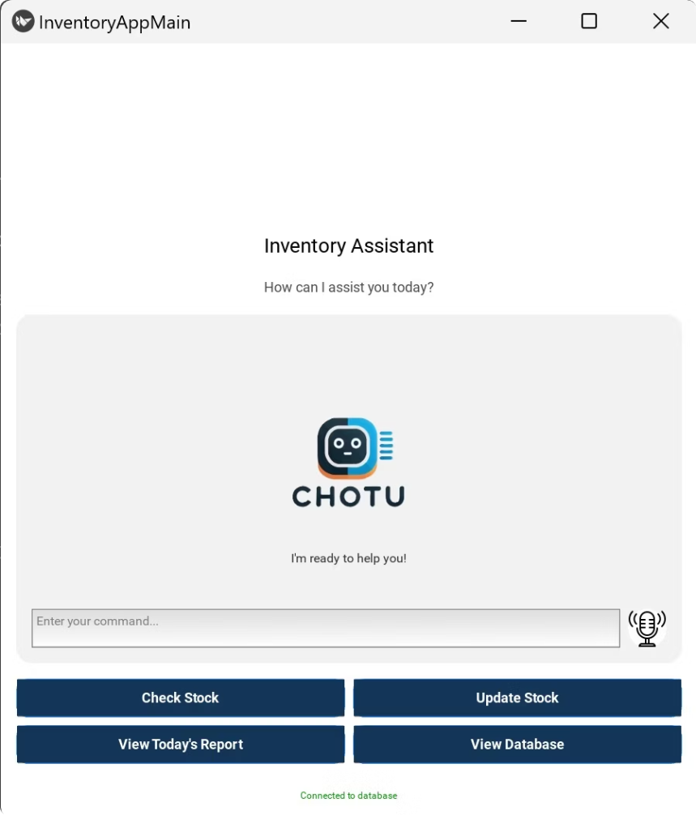
Frontend GUI
A Python-Kivy based frontend GUI built for simplicity and ease of use
Designed specifically for shopkeepers with large buttons and minimal text.
Provides multiple input options – button clicks, text input, and voice commands.

Slide 9
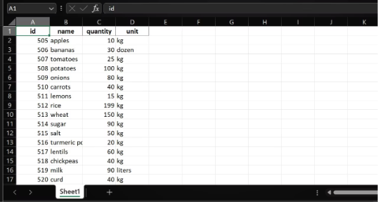
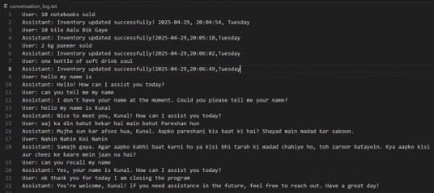
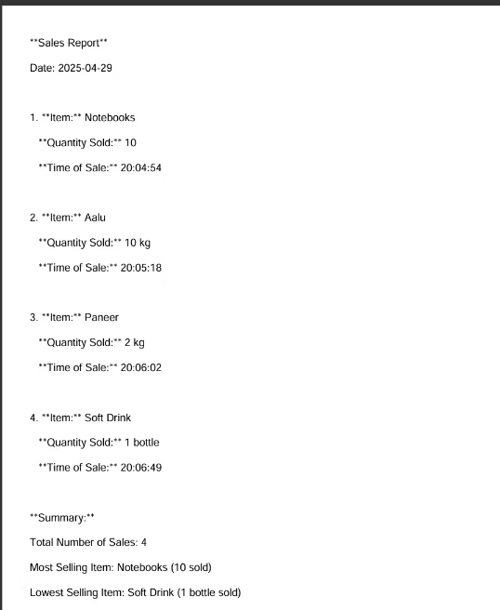

Outputs
Conversation Log
Sample Data
A conversation log is saved, so that its easier for shopkeepers to keep a check on all their chat logs and maintain a record of customer interactions. This log can be accessed and reviewed for reference or analysis purposes. It assists in tracking communication history and ensuring efficient customer service.
A Sample Data which was used to populate the database included product names, quantities, and prices for demonstration purposes. This data was input using the various input options available in the frontend GUI, showcasing the versatility of the system. It also allowed for testing the secure database updates and generating detailed reports for analysis.
Ai generated PDF file
A day-end report which show all the product record that were made that day.

Slide 10





Key Benefits of VocalMart
Time-Saving Operations
User-Friendly Interface
1
2
Fast inventory updates and report generation via voice commands.
Simple GUI and voice support for non-technical users.
Paperless Record-Keeping
Bilingual Voice Support
Automatic digital reports ensure eco-friendly and organized records.
Hindi and English recognition for broad accessibility.
4
3

Slide 11

Future Enhancements Roadmap
Analytics Dashboard
Insightful trends and sales data to optimize stock management.
Barcode Scanner Integration
Speed up checkout and inventory updates with scanning technology.
Low Stock Alerts
Real-time notifications to prevent stockouts and keep shelves stocked.
Cloud Backup
Secure remote storage of sales and inventory data.
Regional Language Support
Adding Punjabi and Marathi to support diverse user needs.

Slide 12

Thank You
We appreciate your time and interest in VocalMart.
We look forward to helping local retailers streamline inventory management with AI voice technology.

